Slide 1

Client-Side Machine Learning with Tensorflow.js
Mohammad M. Khajah
Systems & Software Development Department
Kuwait Institute for Scientific Research

Slide 2
Artificial Intelligence (AI)
Automating tasks that require intelligence: recognizing speech, faces, objects in photos, playing games, etc.
Symbolic
Data-Driven
Explicit A->B rules
Expert systems:
If patient has symptom X -> Y
If Y -> order medication Z
Learns patterns in data
Neural networks, support vector machines, random forests, reinforcement learning, etc.
Machine Learning
Natural representation
Incapable of learning
Unable to deal with uncertainty
hard to know what the systems knows
Can learn new things or polices
Can handle uncertainty
Can require large amounts of data
Notes:
Big Data Analytics is the process of making sense of large sets of data.
You start with a large, noisy observations and you try to extract the fundamental insights from them.
Having Big Data alone is not enough.

Slide 3
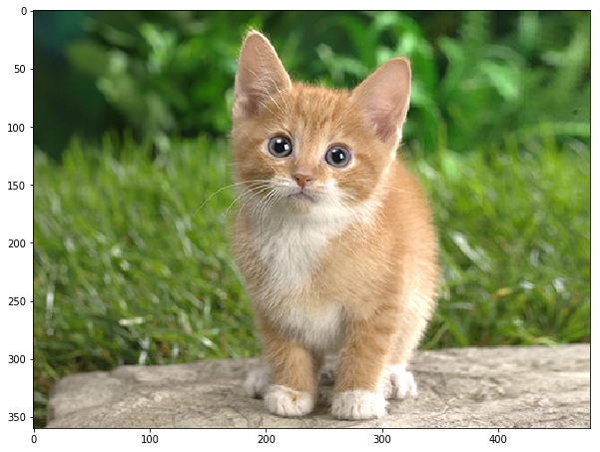
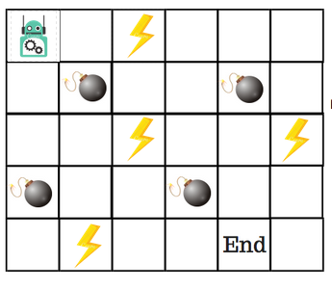
AI & Machine Learning
ML
Model
AI: automates tasks that require intelligence: recognizing speech, faces, objects in photos, playing games, etc.
Machine Learning (ML): algorithms that learn from data
Supervised ML: data takes the form of (input, output) and the task is to predict the output given the input
Unsupervised ML: inputs without outputs, task is to find patterns or clusters in the data
Reinforcement Learning (RL): no input or output is given, have to learn a model of environment and how to optimally act in it
cat

Slide 4
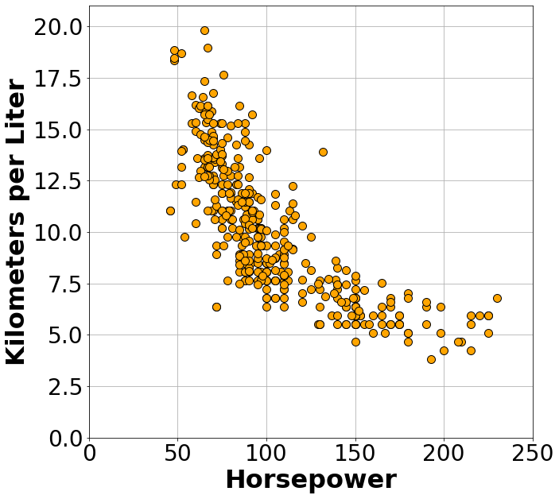
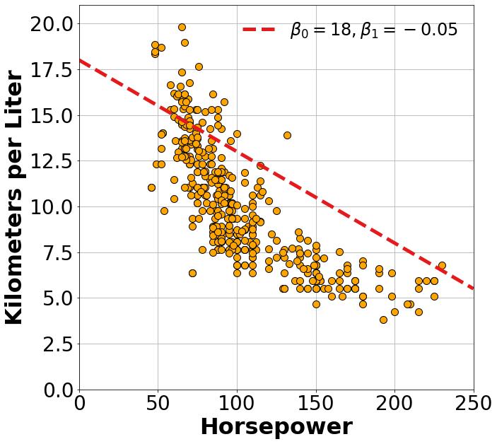
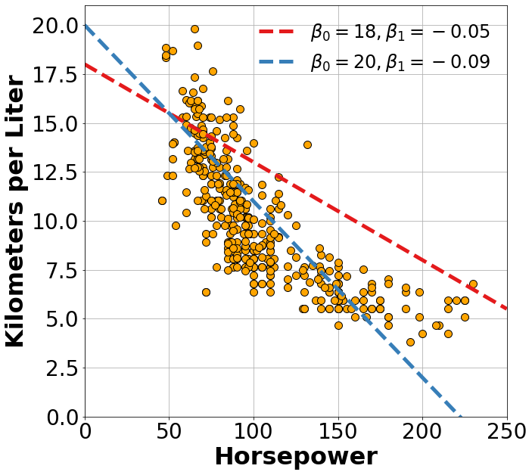
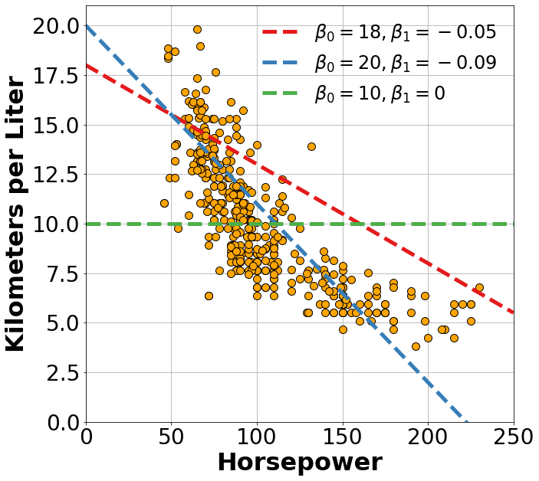
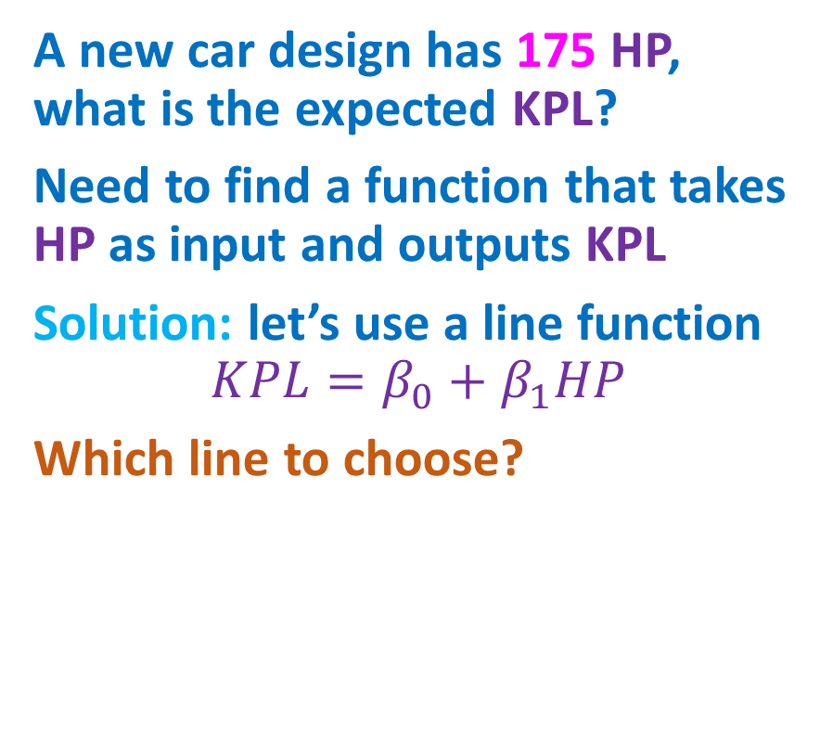
A Linear Neuron
A new car design has 175 HP, what is the expected KPL?
Need to find a function that takes HP as input and outputs KPL
Solution: let’s use a line function
$$KPL=β_{0}+β_{1}HP$$
Which line to choose?
Need an Objective Function

Slide 5
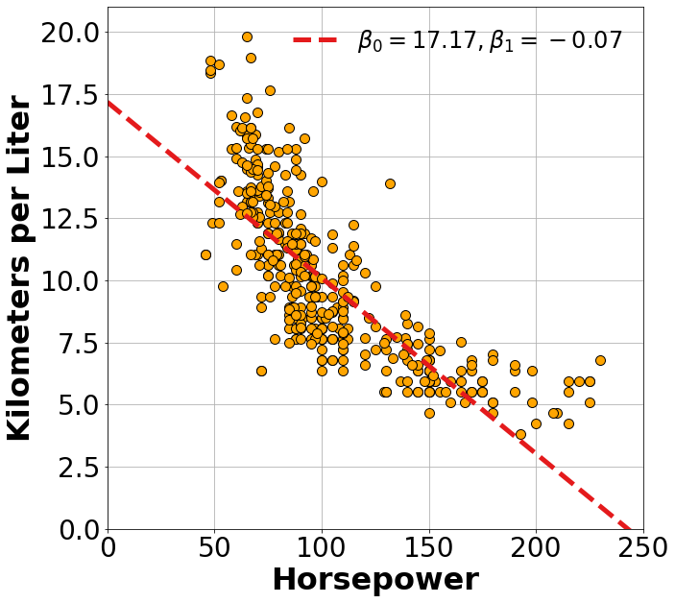
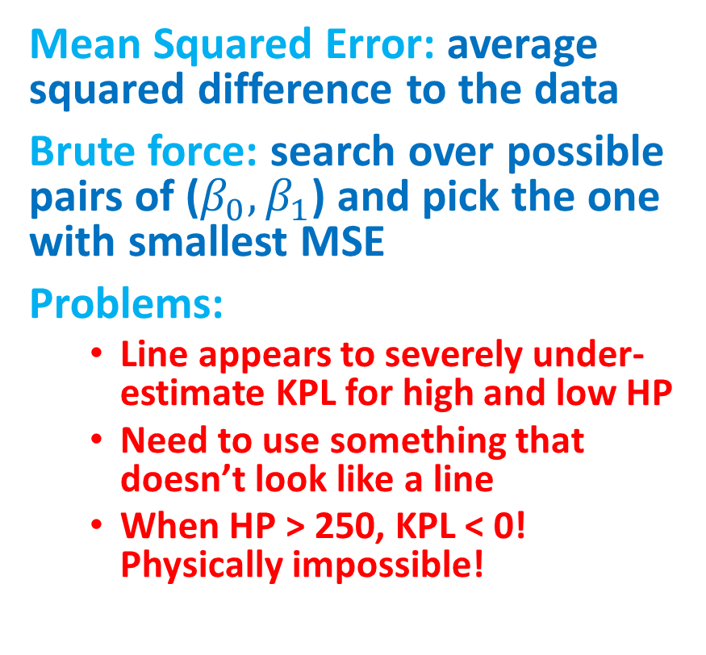
Best Fit
Mean Squared Error: average squared difference to the data
Brute force: search over possible pairs of ($β_{0},β_{1}$) and pick the one with smallest MSE
Problems:
Line appears to severely under-estimate KPL for high and low HP
Need to use something that doesn’t look like a line
When HP > 250, KPL < 0! Physically impossible!

Slide 6
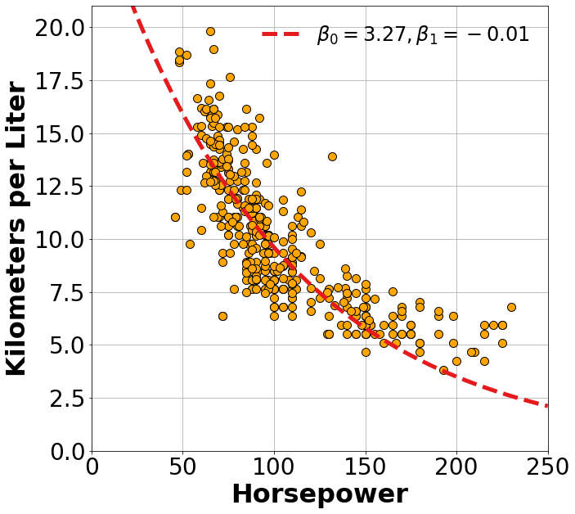
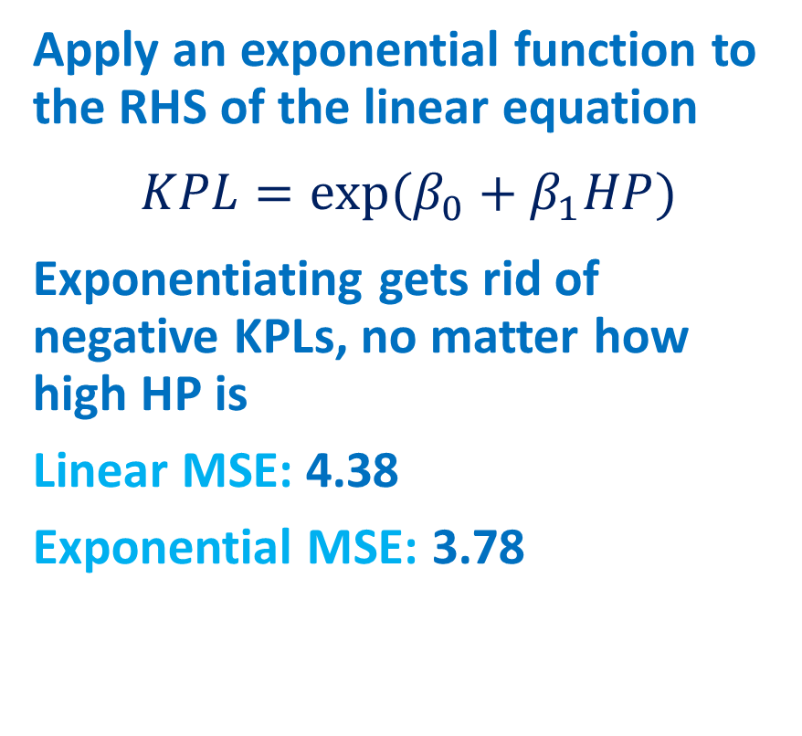
Exponential Neuron
Apply an exponential function to the RHS of the linear equation
$$KPL=exp⁡(β_{0}+β_{1}HP)$$
Exponentiating gets rid of negative KPLs, no matter how high HP is
Linear MSE: 4.38
Exponential MSE: 3.78

Slide 7
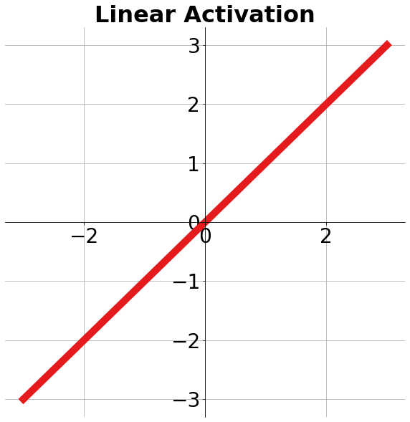
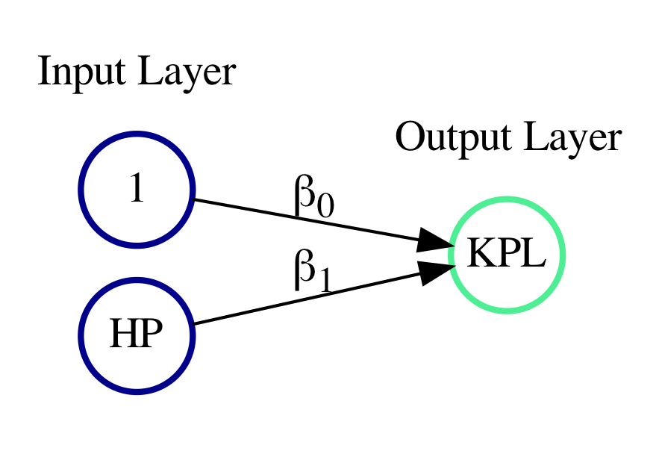
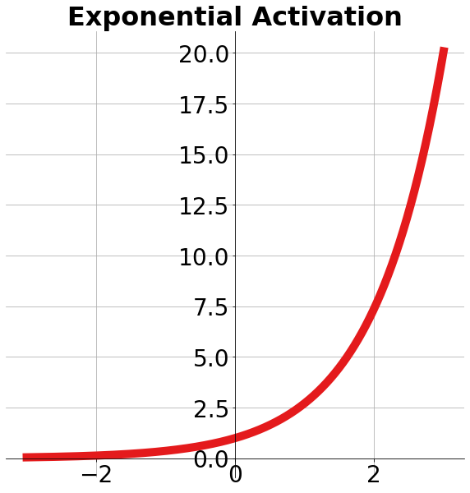
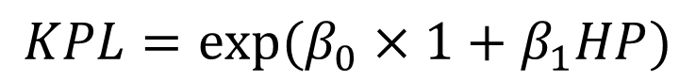
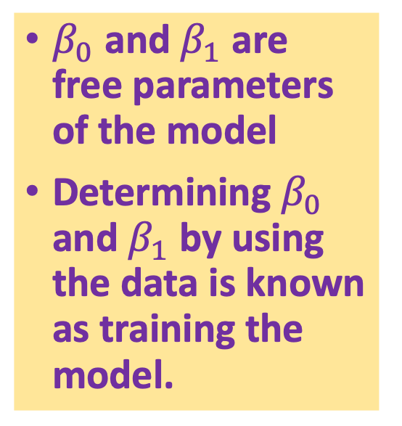
Recap
$β_{0}$ and $β_{1}$ are free parameters of the model
Determining $β_{0}$ and $β_{1}$ by using the data is known as training the model.
Bias
Input
$$KPL=exp⁡(β_{0}×1+β_{1}HP)$$
Activation

Slide 8
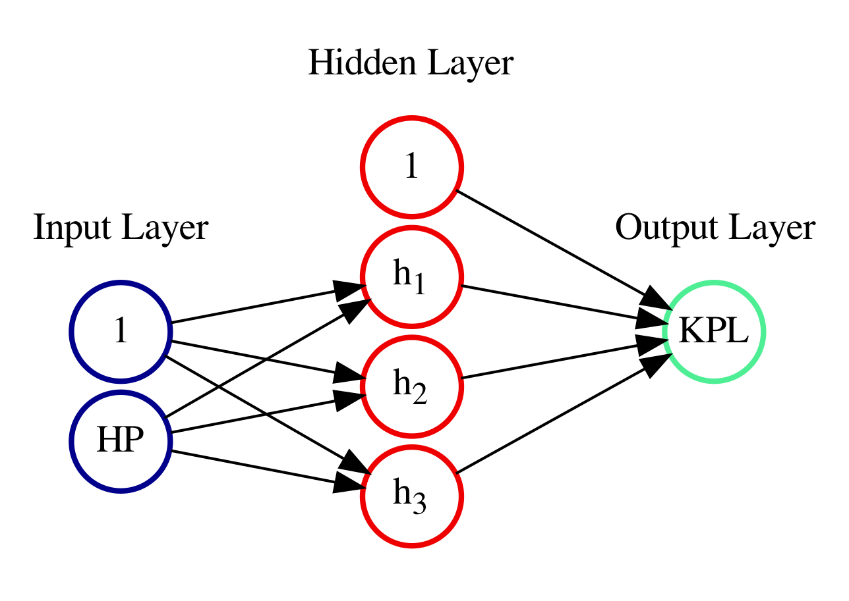
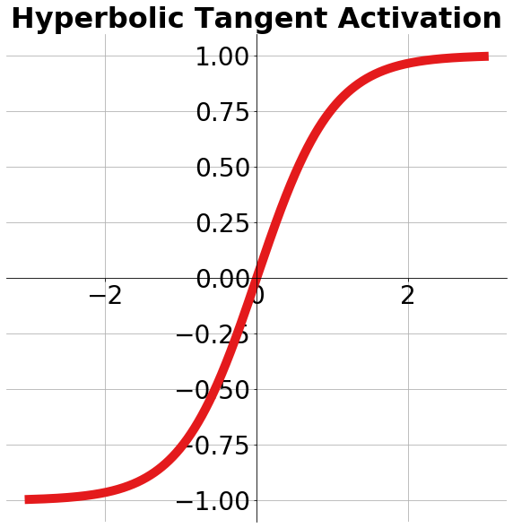
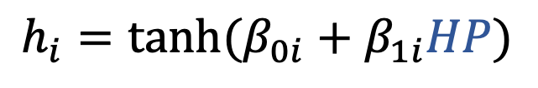
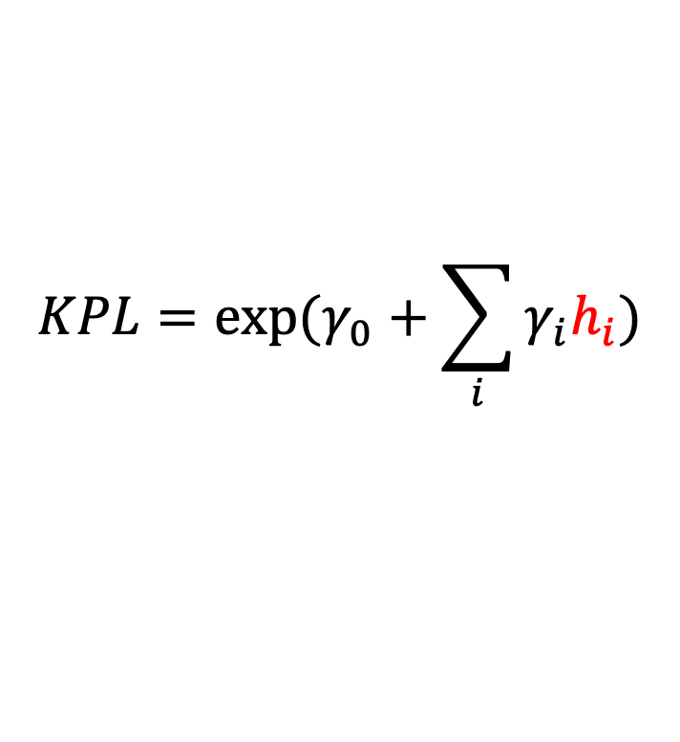
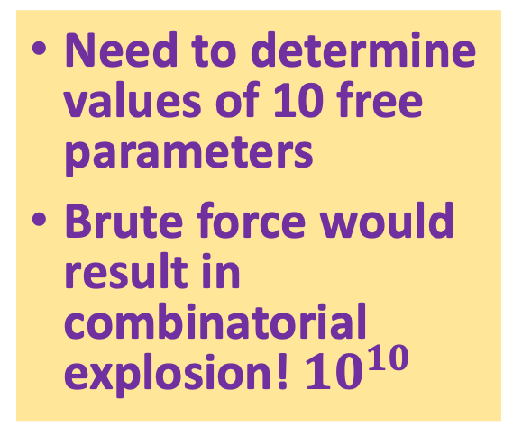
A Network of Neurons
$$KPL=exp⁡(γ_{0}+\sum_{i}{γ_{i}h_{i}})$$
Need to determine values of 10 free parameters
Brute force would result in combinatorial explosion! $10^{10}$
$$h_{i}=tanh⁡(β_{0i}+β_{1i}HP)$$

Slide 9
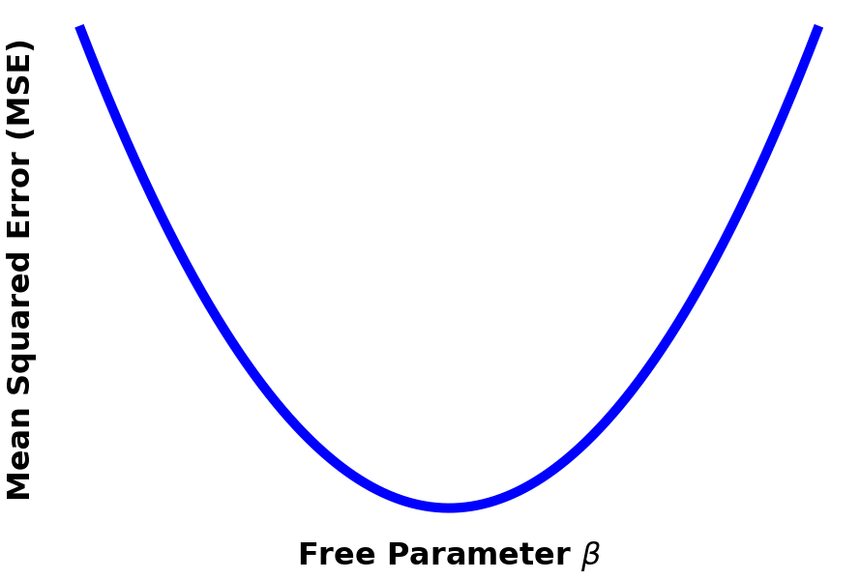
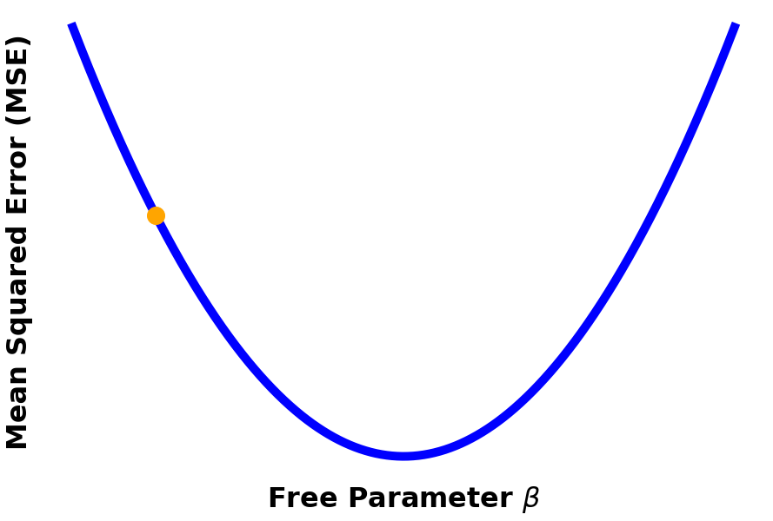
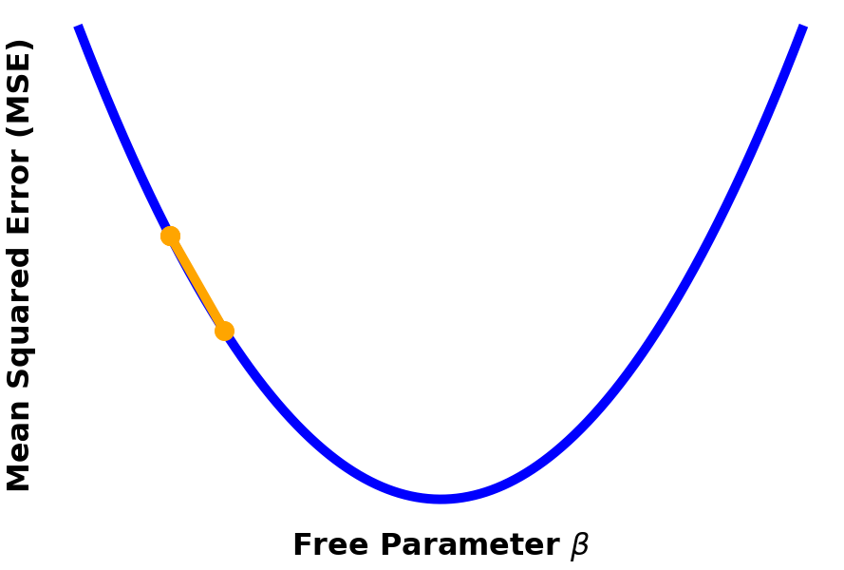
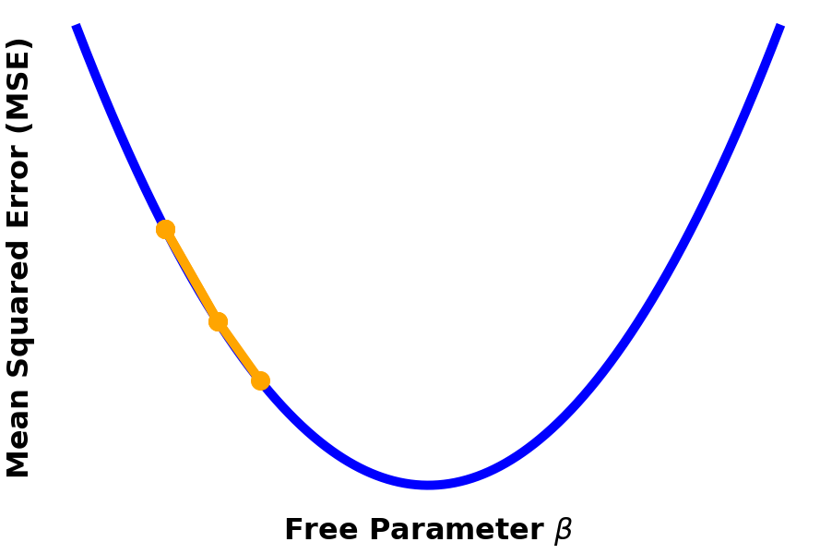
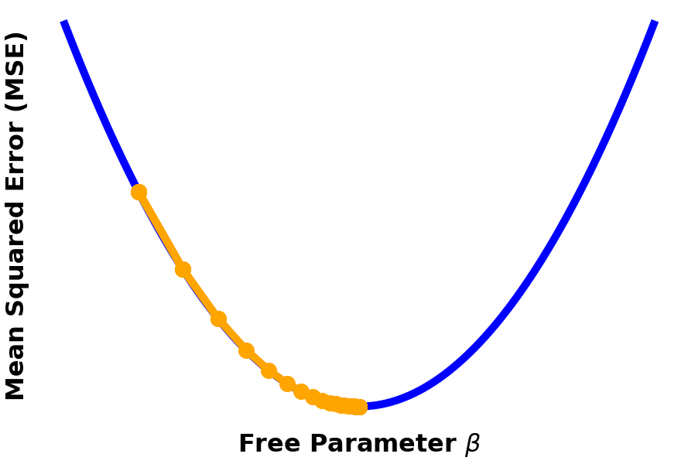
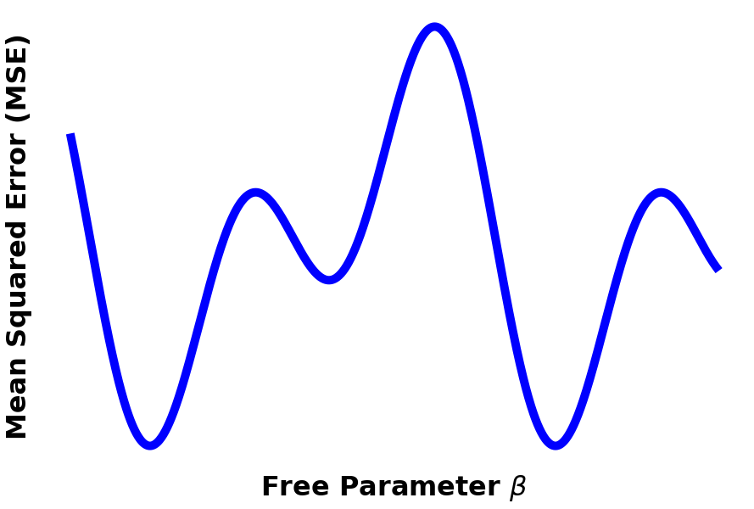
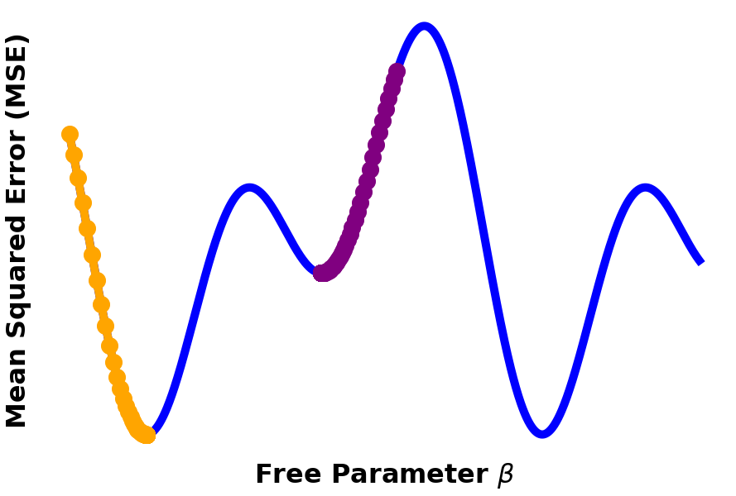
Training a Neural Net: Backpropagation
Intuition: start with random parameter values, then adjust the parameters in the direction that minimizes MSE
Needs calculus: to get the derivative of objective function with respect to free parameters
Non-convexity: reality is rarely this nice, your loss function will likely have multiple local minima
Global
Local

Slide 10
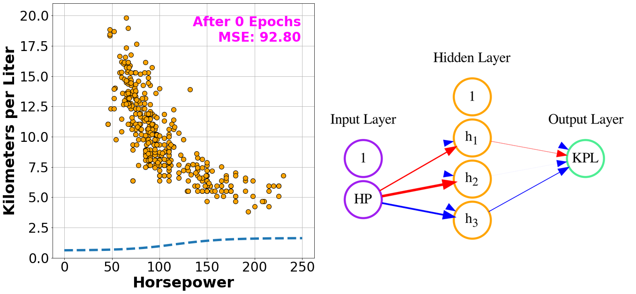
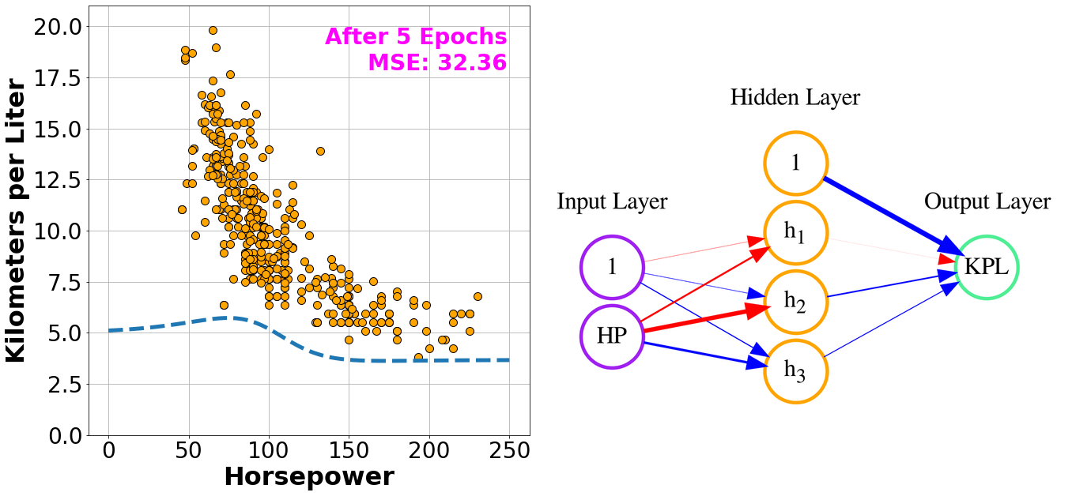
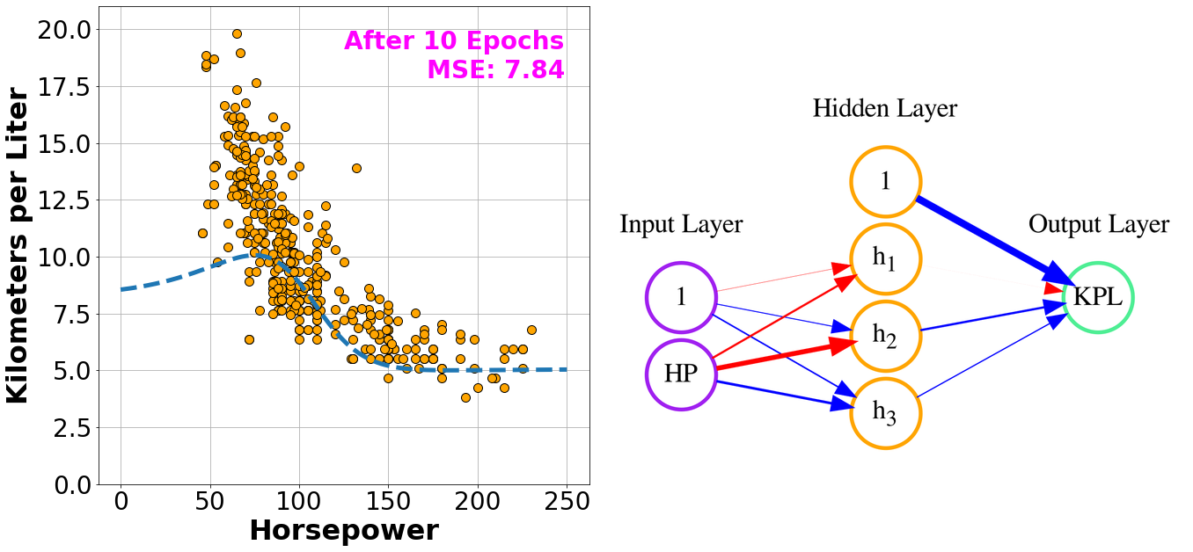
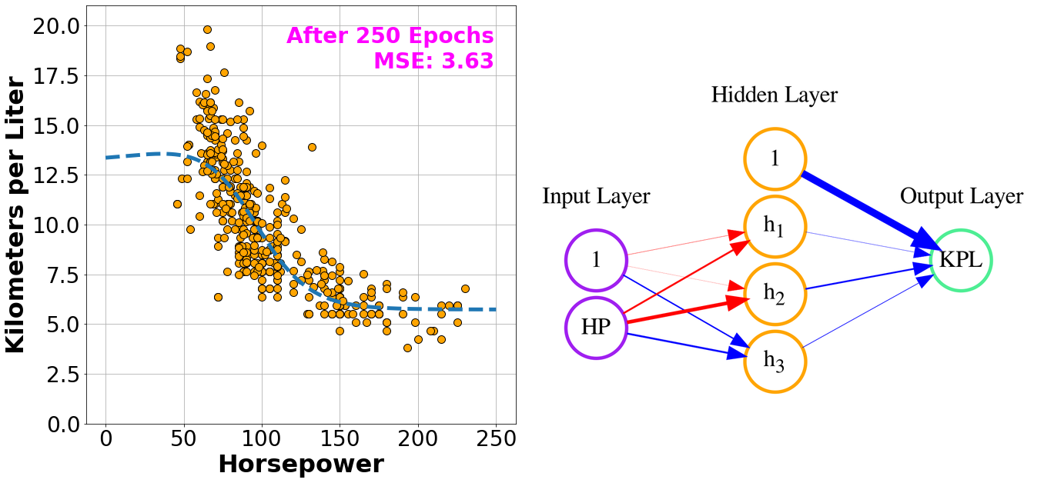
Fitting NN to the Cars Dataset

Slide 11
Simple Diagramming Web App
Recognizes four hand drawn shapes: lines, triangles, rectangles, and ellipses
Once a shape is recognized, the application draws a nice vectorized version of the shape
We only demo the recognition part of the app, afterwards, it can easily be extended into a useful diagramming application
All of this happens in the web browser, nothing gets sent to the server

Slide 12
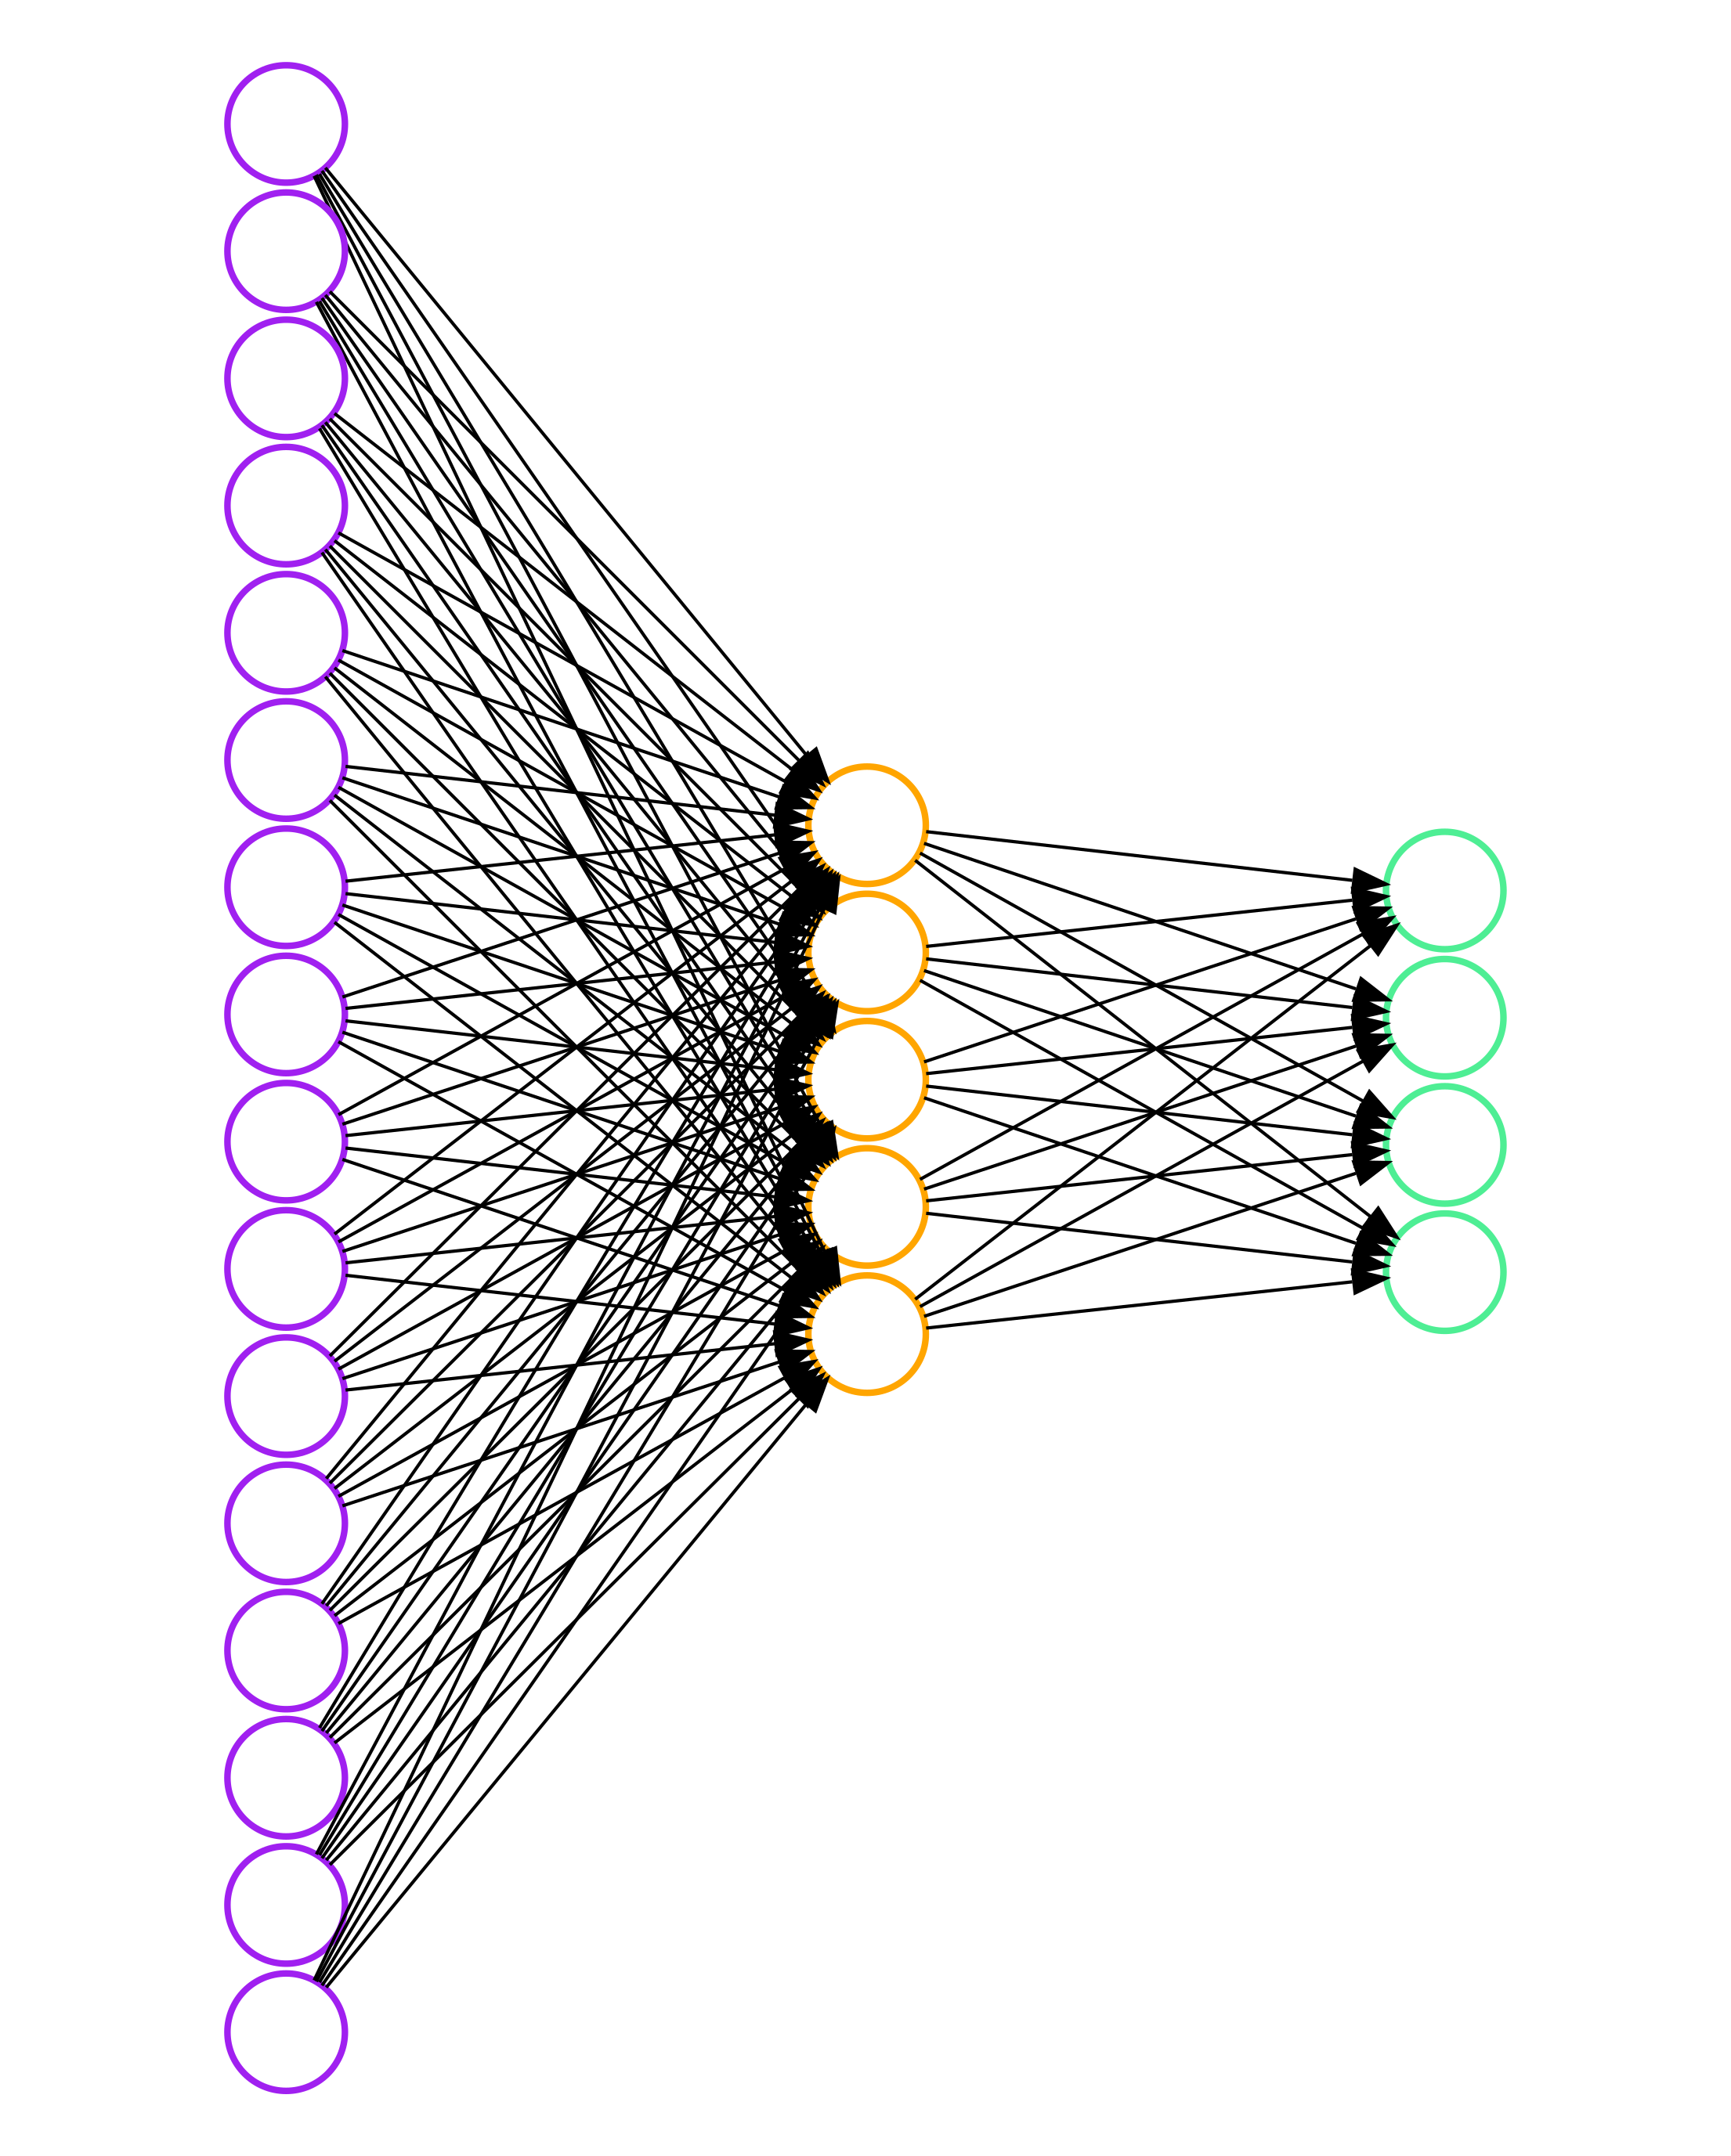
Shape Recognition Flow
User draws a shape
Down-sample and resize
(30x30)
Flatten
Predict
softmax units
tanh units
P(line)
P(triangle)
P(rectangle)
P(ellipse)
= 0.1
= 0.1
= 0.5
= 0.3
Objective: Probability of Observations
(Categorical Cross Entropy)
To help model, aspect ratio NOT preserved

Slide 13
Tensorflow.js
const model = tf.sequential();
const hiddenLayer = tf.layers.dense({
inputShape: [900],
units: 10,
activation: 'tanh',
useBias: true
});
const outputLayer = tf.layers.dense({
units: 4,
useBias: true,
activation: 'softmax'
}); model.add(hiddenLayer);
model.add(outputLayer); const optimizer = tf.train.adam(0.0001);
model.compile({
optimizer: optimizer,
loss: 'categoricalCrossentropy',
metrics: ['accuracy'],
});
Feedforward arch
Hidden Layer
A graph computational engine written in Javascript and uses WebGL for accelerating math operations
Makes implementing NNs very easy: just specify architecture, training algorithm, and objective
The library calculates derivatives automatically, no math required (yay!)
Output Layer
Backprop Algorithm
Initialize model

Slide 14
Training
const trainingInputs = [
,
,
,
]
const trainingOutputs = [
,
,
,
…
]
Rectangle
Ellipse
Triangle
…..
Line
await model.fit(tf.tensor(trainingInputs), tf.tensor(trainingOutputs), {
epochs: 500,
shuffle: true,
callbacks: {
onEpochEnd: function(b, l) { console.log(l) }
})
Don’t block
Must convert to TF tensors

Slide 15
Inference (Prediction)
const testingInputs = [
]
const preds = model.predict(tf.tensor(testingInputs));
// preds = tf.tensor([
// [0.3, 0.1, 0.5, 0.1]
// ])
// preds is a 1x4 matrix
const hardPreds = preds.argMax(1).arraySync();
get the INDEX of the maximum element along the columns of the matrix (axis=1)
Convert result back to regular JS array
(non-blocking version available)
// hardPreds = [2]
// 2 is the index of SQUARE label

Slide 16
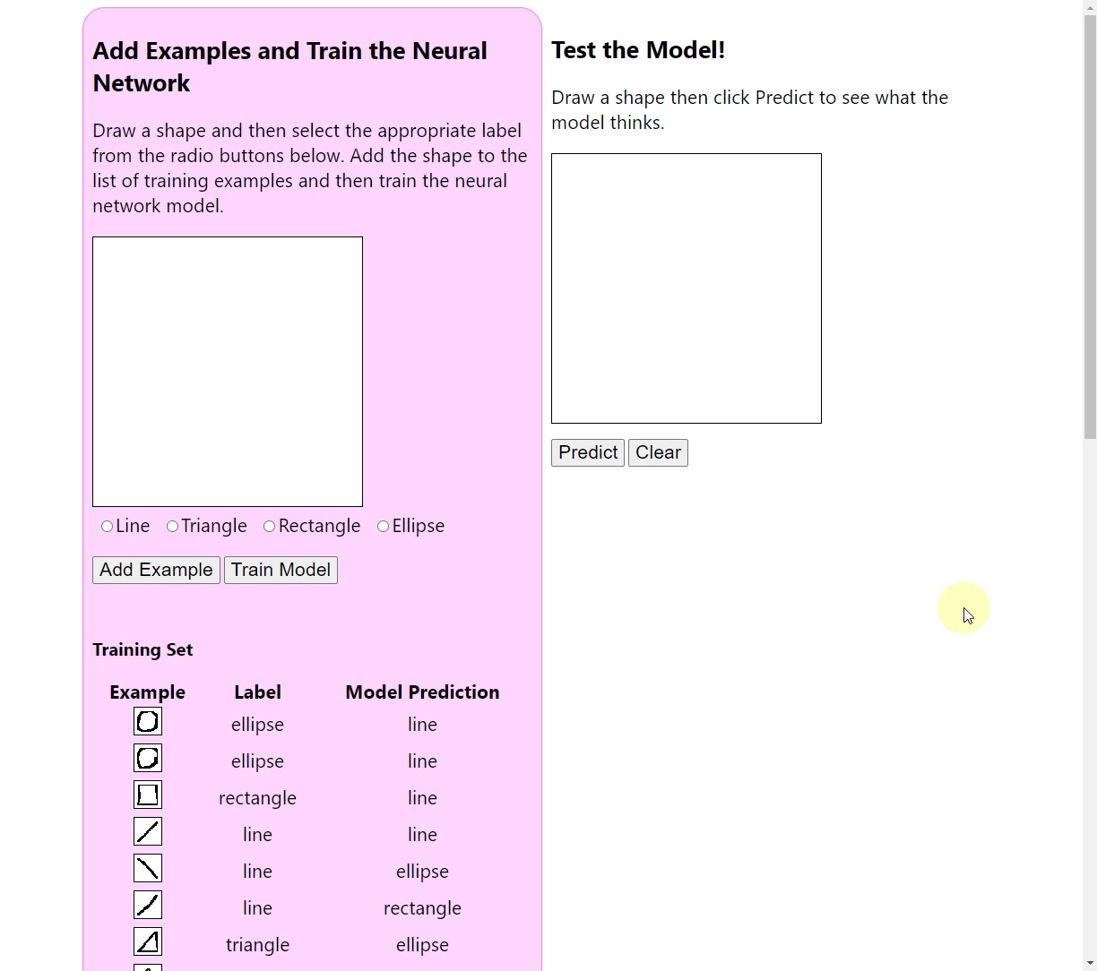

Slide 17
Where to go From Here
Training/testing: validate the model quantitatively by measuring its accuracy on unseen examples
Pre-training: train the model on off-line (via Tensorflow in Python) and then deploy to client
Convolutional Neural Networks (CNNs): specifically designed to handle images, exploiting things such as local proximity and parameter sharing
code available at
https://github.com/KISRDevelopment/client-side-ml

